Slide 1
Speed part 1
Barb Ericson
Georgia Institute of Technology
May 2006

Slide 2
Learning Goals
Computing Concepts
  An introduction to machine language
  The difference between interpreted and compiled languages
  To understand the categories of algorithms
    Included ones that can't be written
  To make decisions about computer storage when optimizing for speed

Slide 3
Questions
Why is it faster to do image manipulations in Photoshop than in our Java programs?
How fast can we get our programs to go?
  Are there ways to make them faster?
  Are there programs that can't be written?
Does it always take this long to write programs?
  Are there easier ways to do it?
What does another programming language look like?
Notes:
At this point you may have any of these questions. The answers to these questions are part of computer science.

Slide 4
What Computers Understand
Computers don't really understand Java, C, Visual Basic, or any other high-level language
  They understand a low-level language called machine language
  Machine language is an assignment of computer operations to byte values
    So it looks like a series of numbers
    That stand for addition, subtraction, division, multiplication, storing, loading, and jumping

Slide 5
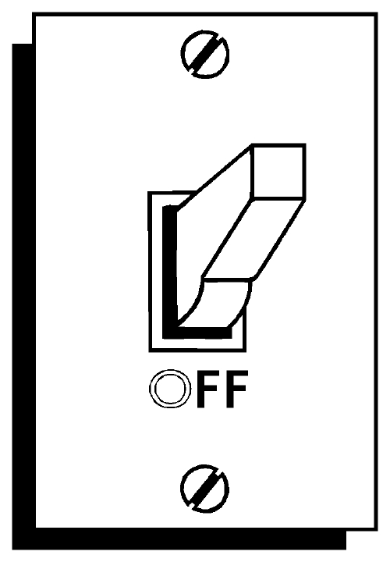
Understanding Machine Language
The computer doesn’t really understand machine language.
The computer is just a machine, with lots of switches that make data flow this way or that way.
Machine language is just a bunch of switch settings that cause the computer to do a bunch of other switch settings.
We interpret a pattern of switches to be commands for addition, subtraction, loading, and storing.
  In the end, it’s all about encoding.
A byte of switches

Slide 6
Assembler and Machine Language
Machine language looks just like a bunch of numbers.
Assembler language is a set of words that corresponds to the machine language.
  It’s a one-to-one relationship.
  A word of assembler equals one machine language instruction, typically.
    (Often, just a single byte.)
Notes:
Assembler language is also called Assembly language

Slide 7
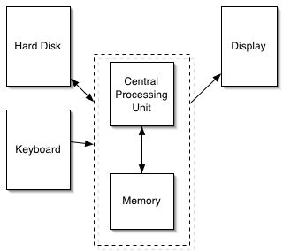
There are Different Machine Languages
Apple computers used CPU (processor) chips called G3 or G4.
Computers running Microsoft Windows use Pentium processors.
There are other processors called Alpha, LSI-11, and on and on.
Each processor understands only its own machine language

Slide 8
Assembler instructions
Assembler instructions tell the computer to do things like:
  Store numbers into particular memory locations or into special locations (registers) in the computer
  Test numbers for equality, greater-than, or less-than
  Add numbers together, or subtract them
  Jump to another program instruction

Slide 9
An Example Assembly Language Program
LOAD #10,R0 ; Load register R0 with 10
LOAD #12,R1 ; Load register R1 with 12
SUM R0,R1 ; Add registers R0 and R1
STOR R1,#45 ; Store the result into memory
You can picture memory as a long series of post office boxes in a mailroom.
Each one has a number (like #45).

Slide 10
Assembler -> Machine
LOAD 10,R0 ; Load register R0 with 10
LOAD 12,R1 ; Load register R1 with 12
SUM R0,R1 ; Add register R0 and R1
STOR R1,#45 ; Store the result into
; memory location #45
Might appear in memory as just 12 bytes:
01 00 10
01 01 12
02 00 01
03 01 45

Slide 11
Another Example
LOAD R1,#65536 ; Get a character from keyboard
TEST R1,#13 ; Is it an ASCII 13 (Enter)?
JUMPTRUE #32768 ; If true, go to another part of the program
CALL #16384 ; If false, call func. to process the new line
Machine Language:
05 01 255 255
10 01 13
20 127 255
122 63 255

Slide 12
Devices are also just memory
A computer can interact with external devices
  displays, microphones, and speakers
The easiest way to understand it (and is often the actual way it’s implemented) is to think about external devices as corresponding to a memory location.
  Store a 255 into location 65,542, and suddenly the red component of the pixel at 101,345 on your screen is set to maximum intensity.
So simple loads and stores handle multimedia, too.

Slide 13
Machine language is executed very quickly
A mid-range laptop has a clock rate of 1.5 Gigahertz.
What that means exactly is hard to explain, but let’s interpret it as processing 1.5 billion bytes per second.
Those 12 bytes would execute inside the computer, then, in 12/1,500,000,000th of a second!

Slide 14
Applications are typically compiled
Applications like Adobe Photoshop and Microsoft Word are compiled.
  This means that they execute in the computer as pure machine language.
  They execute at that level speed.
However, Python and Java are interpreted.
  They execute at a slower speed.
  Why? It’s the difference between translating instructions and directly executing instructions.

Slide 15
Exercise
Read about assembly languages at http://en.wikipedia.org/wiki/Assembly_language
Read about the history of assembly languages at http://inventors.about.com/od/bstartinventors/a/John_Backus.htm
Read about Admiral Grace Hopper at http://www.cs.yale.edu/homes/tap/Files/hopper-story.html
  What did she do to make programming easier?

Slide 16
Summary
Computers really only understand machine language
  Assembler maps to machine language
  Each processor type has its own machine language
  In assembler you can load a register from a memory address, store a register value into a memory address, jump to another instruction, compare values in registers
  Some languages are compiled into machine language
    And thus run quickly
  Some languages are interpreted
    Have an extra step before they can run

